Slide 1

Shopify Sales & Customer Analytics
Name :- AYUSH DASH
Data :- 31st July, 2026
内容由AI生成

Slide 2

01
Section 1: Opening
Contents
02
Section 2: Dataset
03
Section 3: DAX
04
Section 4: Dashboard Pages
05
Section 5: Insights
06
Section 6: Closing
内容由AI生成

Slide 3
Section 1: Opening
01
内容由AI生成

Slide 4

Cover Slide
Title and Subtitle
Large dashboard mockup background with title "Shopify Sales Analytics Dashboard" and subtitle "Executive Business Intelligence Dashboard using Power BI & DAX". Presenter info: Ayush Dash, Data Analyst Portfolio.
内容由AI生成

Slide 5
Executive Summary
Business Objective & Dataset
Left side: Business Objective, Dataset, Dashboard Pages. Right side: 6 dashboard thumbnails, Power BI logo, Shopify logo. Bottom: This project transforms raw Shopify sales data into interactive executive dashboards that support strategic business decision-making.
内容由AI生成

Slide 6

Business Problem
Six Pain Points
Sales scattered, No KPI monitoring, Customer retention unknown, Product performance unclear, Regional sales not tracked, Decisions based on spreadsheets. Outcome: Need a Business Intelligence Dashboard.
内容由AI生成

Slide 7
Business Objectives
Six Strategic Goals
Revenue → Customer → Product → Region → Retention → Executive Decision Making. Each represented as a circular icon.
内容由AI生成

Slide 8

Solution Architecture
End-to-End Flow
CSV → Power Query → Data Cleaning → Data Model → DAX → Power BI Dashboard → Business Insights → Decision Making. A professional flow diagram.
内容由AI生成

Slide 9
Section 2: Dataset
02
内容由AI生成

Slide 10

Dataset Overview
Data Composition
18 columns covering Sales, Orders, Customers, Products, and Locations. Clean structured dataset for analysis.
内容由AI生成

Slide 11

Dataset Statistics
Key Numbers
Large KPI cards displaying: Rows, Columns, Countries, Cities, Customers, Products. Designed like a dashboard.
内容由AI生成

Slide 12
Data Dictionary
Column Definitions
🏷 Column | 🏷 Meaning
🏷 Order Number | Unique order identifier
👤 Customer ID | Unique customer
📦 Product Type | Product category
💳 Total Price Usd | Order revenue in USD
📅 Order Date | Date of purchase
🌍 Country | Customer location
🏙️ City | Customer city
🔄 Repeat Purchase | Whether customer has ordered before
内容由AI生成

Slide 13

Power Query Transformation
Data Cleaning Steps
Raw Data → Handle Missing Values → Set Data Types → Remove Duplicates → Final Cleaned Dataset.
内容由AI生成

Slide 14

Data Model
Entity Relationships
Fact Table (Sales) connected to dimension tables: Customer, Product, Date, Location. Professional redrawn schema.
内容由AI生成

Slide 15
Section 3: DAX
03
内容由AI生成

Slide 16

Business KPIs
Key Performance Indicators
KPI cards for: Revenue, Orders, Customers, CLV, AOV, Repeat Rate. Each with value and trend.
内容由AI生成

Slide 17

DAX Categories
Measure Groups
Sales: Total Revenue, Total Orders, Revenue Running Total. Customer: CLV, Purchase Frequency, Repeat Purchase Rate. Product: Revenue per Product. Financial: Tax, Average Tax %.
内容由AI生成

Slide 18

Important DAX Formulas
Core Measures
Total Revenue = SUM('shopify_sales'[Total Price Usd])
Average Order Value = DIVIDE([Total Revenue],[Total Orders])
Revenue per Customer = DIVIDE([Total Revenue],[Total Customers])
内容由AI生成

Slide 19
Advanced DAX Logic
Measures with Business Purpose
Measure | Business Purpose
Running Total | Track cumulative revenue
Customer Rank | Identify top customers
Purchase Frequency | Measure buying behavior
CLV | Estimate long-term customer value
内容由AI生成

Slide 20

KPI Framework
Metric Hierarchy
Revenue → Orders, AOV, Quantity.
Customers → Frequency, CLV, Repeat Rate. Hierarchical relationship diagram.
内容由AI生成

Slide 21
Section 4: Dashboard Pages
04
内容由AI生成

Slide 22

Standard Dashboard Page Layout
Template Structure
Dashboard Screenshot → Purpose → KPIs Used → Visuals Used → Business Questions → Key Insights → Business Recommendation. Each page is a consulting case study.
内容由AI生成

Slide 23
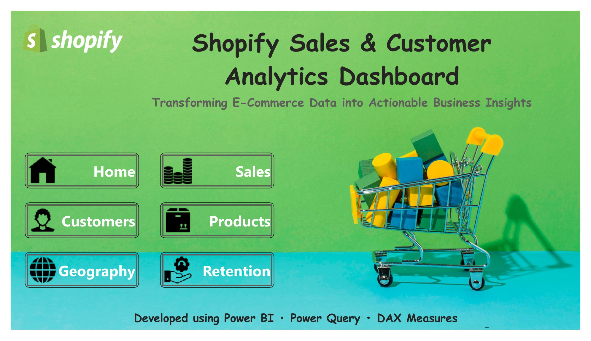
Navigation Page Layout
内容由AI生成

Slide 24

Example: Sales Overview Dashboard
Page Breakdown
Purpose: Monitor overall revenue trends. KPIs: Revenue, Orders, AOV. Visuals: Line chart, KPI cards. Question: How is revenue performing over time? Insight: Stable trend with peak month. Recommendation: Focus marketing on top periods.
内容由AI生成

Slide 25
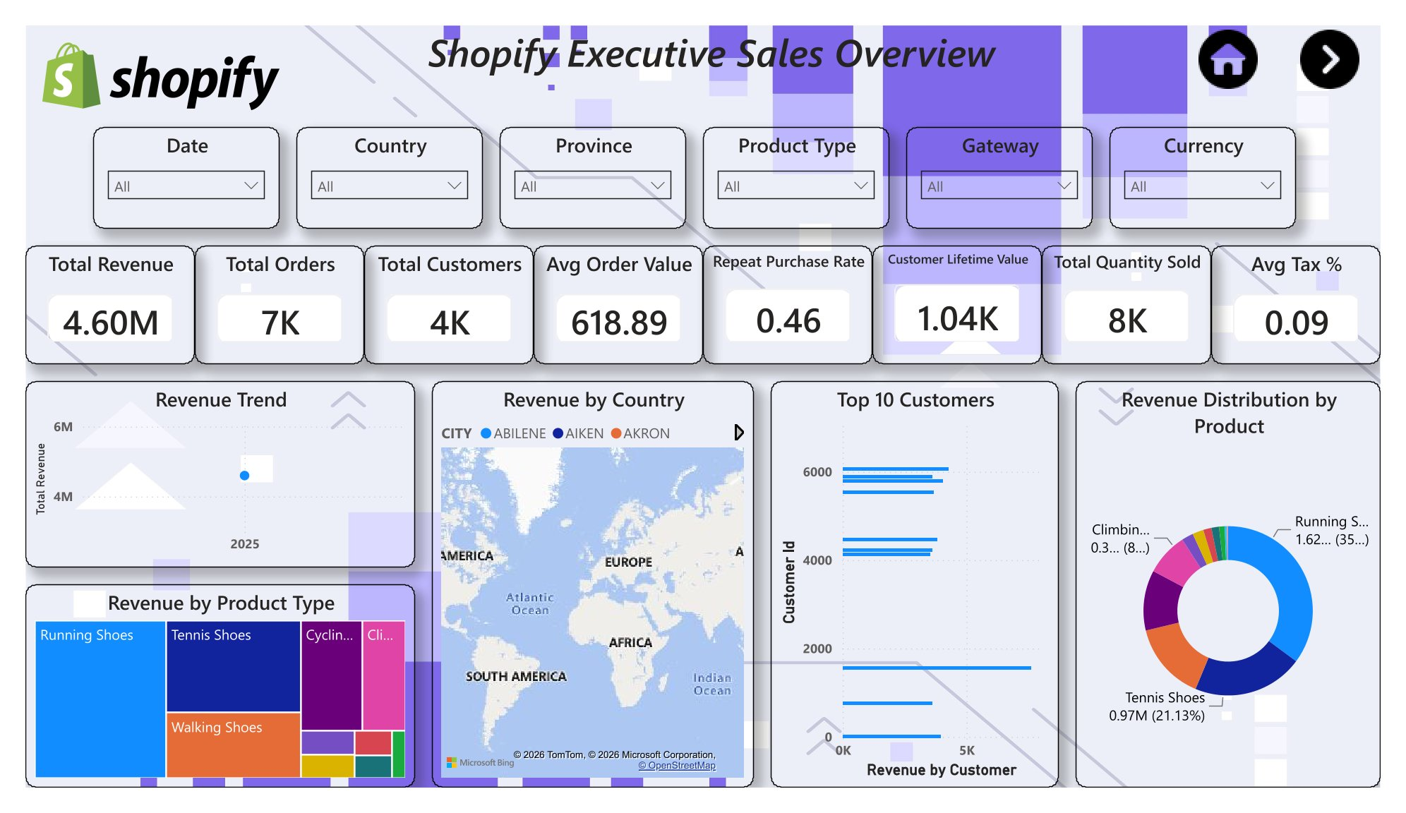
Executive Sales Page Layout
内容由AI生成

Slide 26
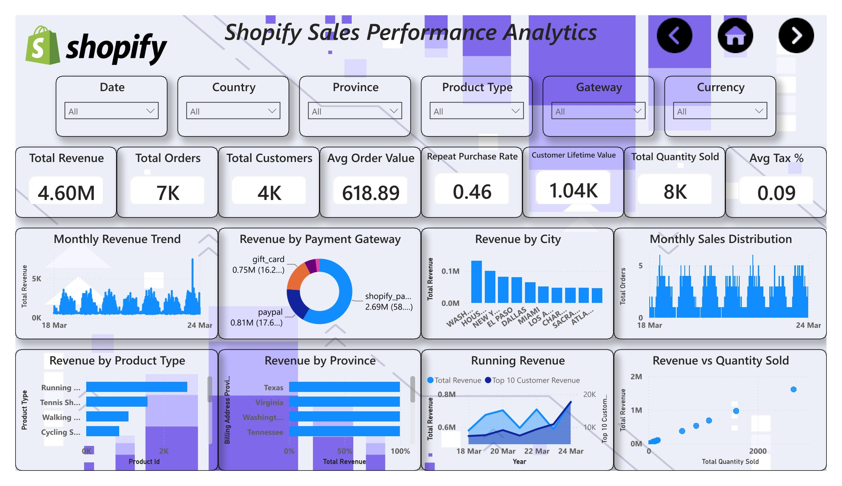
Sales Performance Page Layout
内容由AI生成

Slide 27
Example: Customer Analytics Dashboard
Page Breakdown
Purpose: Understand customer behavior. KPIs: CLV, Repeat Rate, Frequency. Visuals: Bar chart, scatter plot. Question: Which customers drive most value? Insight: Small group contributes large share. Recommendation: Launch loyalty program.
内容由AI生成

Slide 28
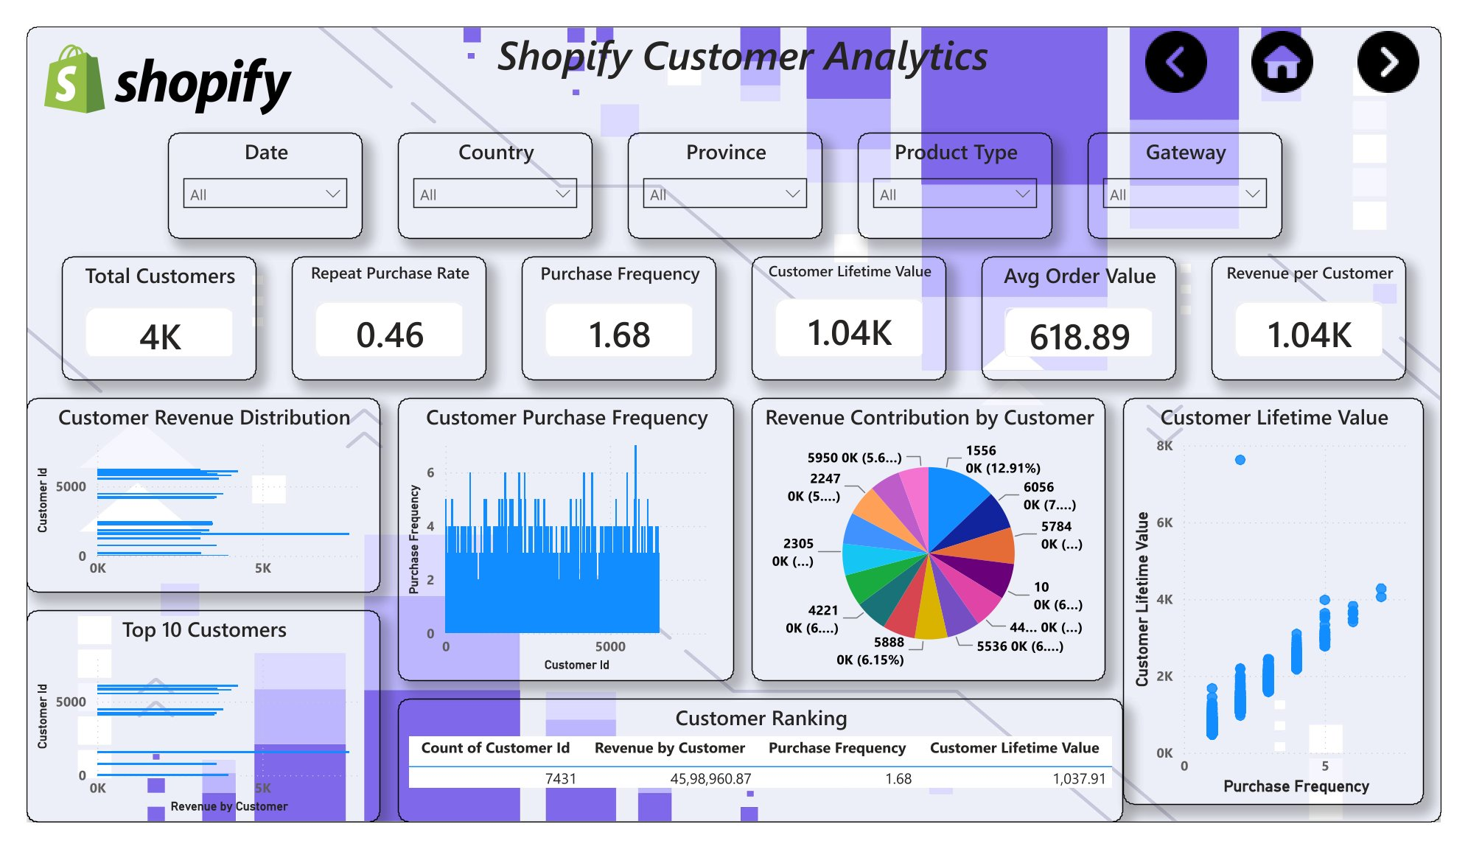
Customer Page Layout
内容由AI生成

Slide 29
Section 5: Insights
05
内容由AI生成

Slide 30
Revenue Trend
Stable Performance
Revenue trend remained stable over the selected period. Peak sales occurred during the highest-performing month.
内容由AI生成

Slide 31
Customer Behavior
High-Value Segments
A small group of customers contributed a large share of revenue. Increasing repeat purchases could significantly improve overall sales.
内容由AI生成

Slide 32
Product Analysis
Leading Categories
The leading product category generated the highest revenue. Lower-performing categories present optimization opportunities.
内容由AI生成

Slide 33
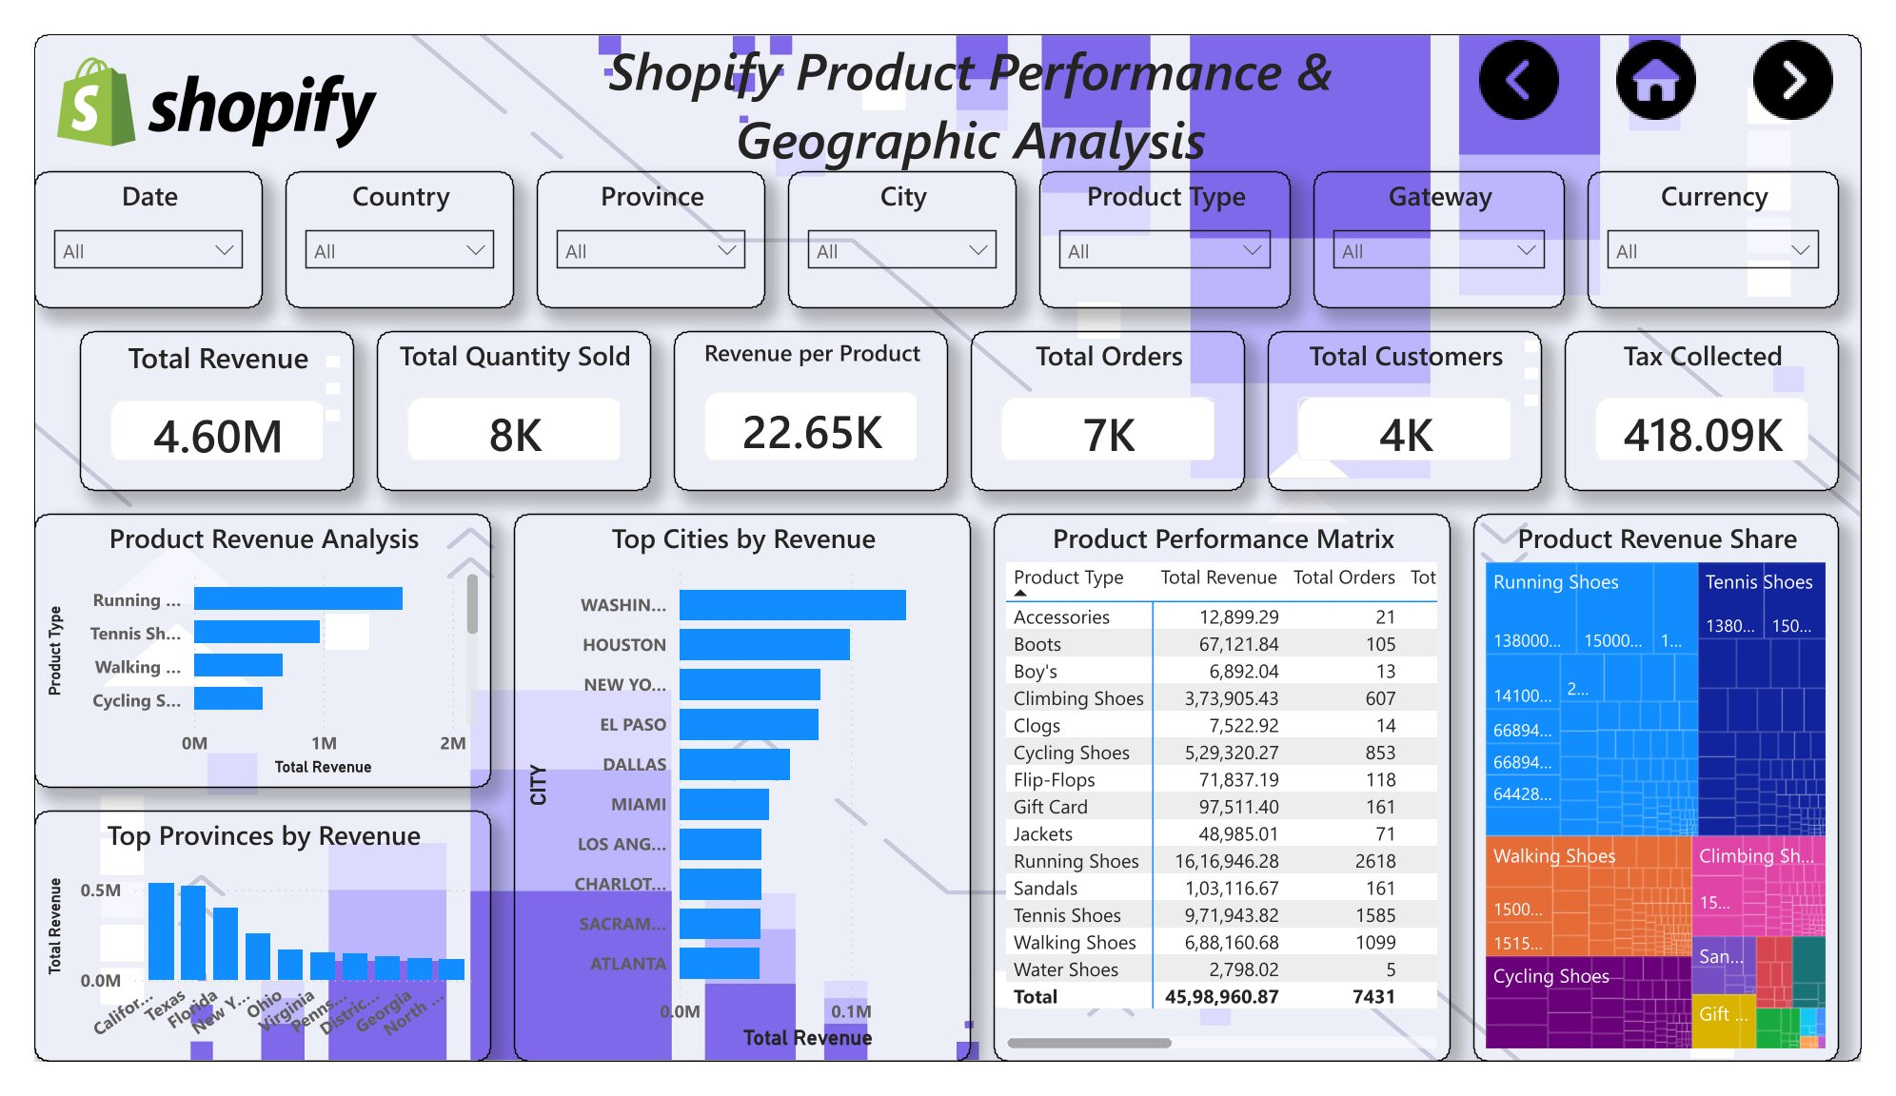
Product Page Layout
内容由AI生成

Slide 34
Geographic Performance
Regional Concentration
Revenue is concentrated in a few key regions. Expansion efforts should target underperforming markets.
内容由AI生成

Slide 35
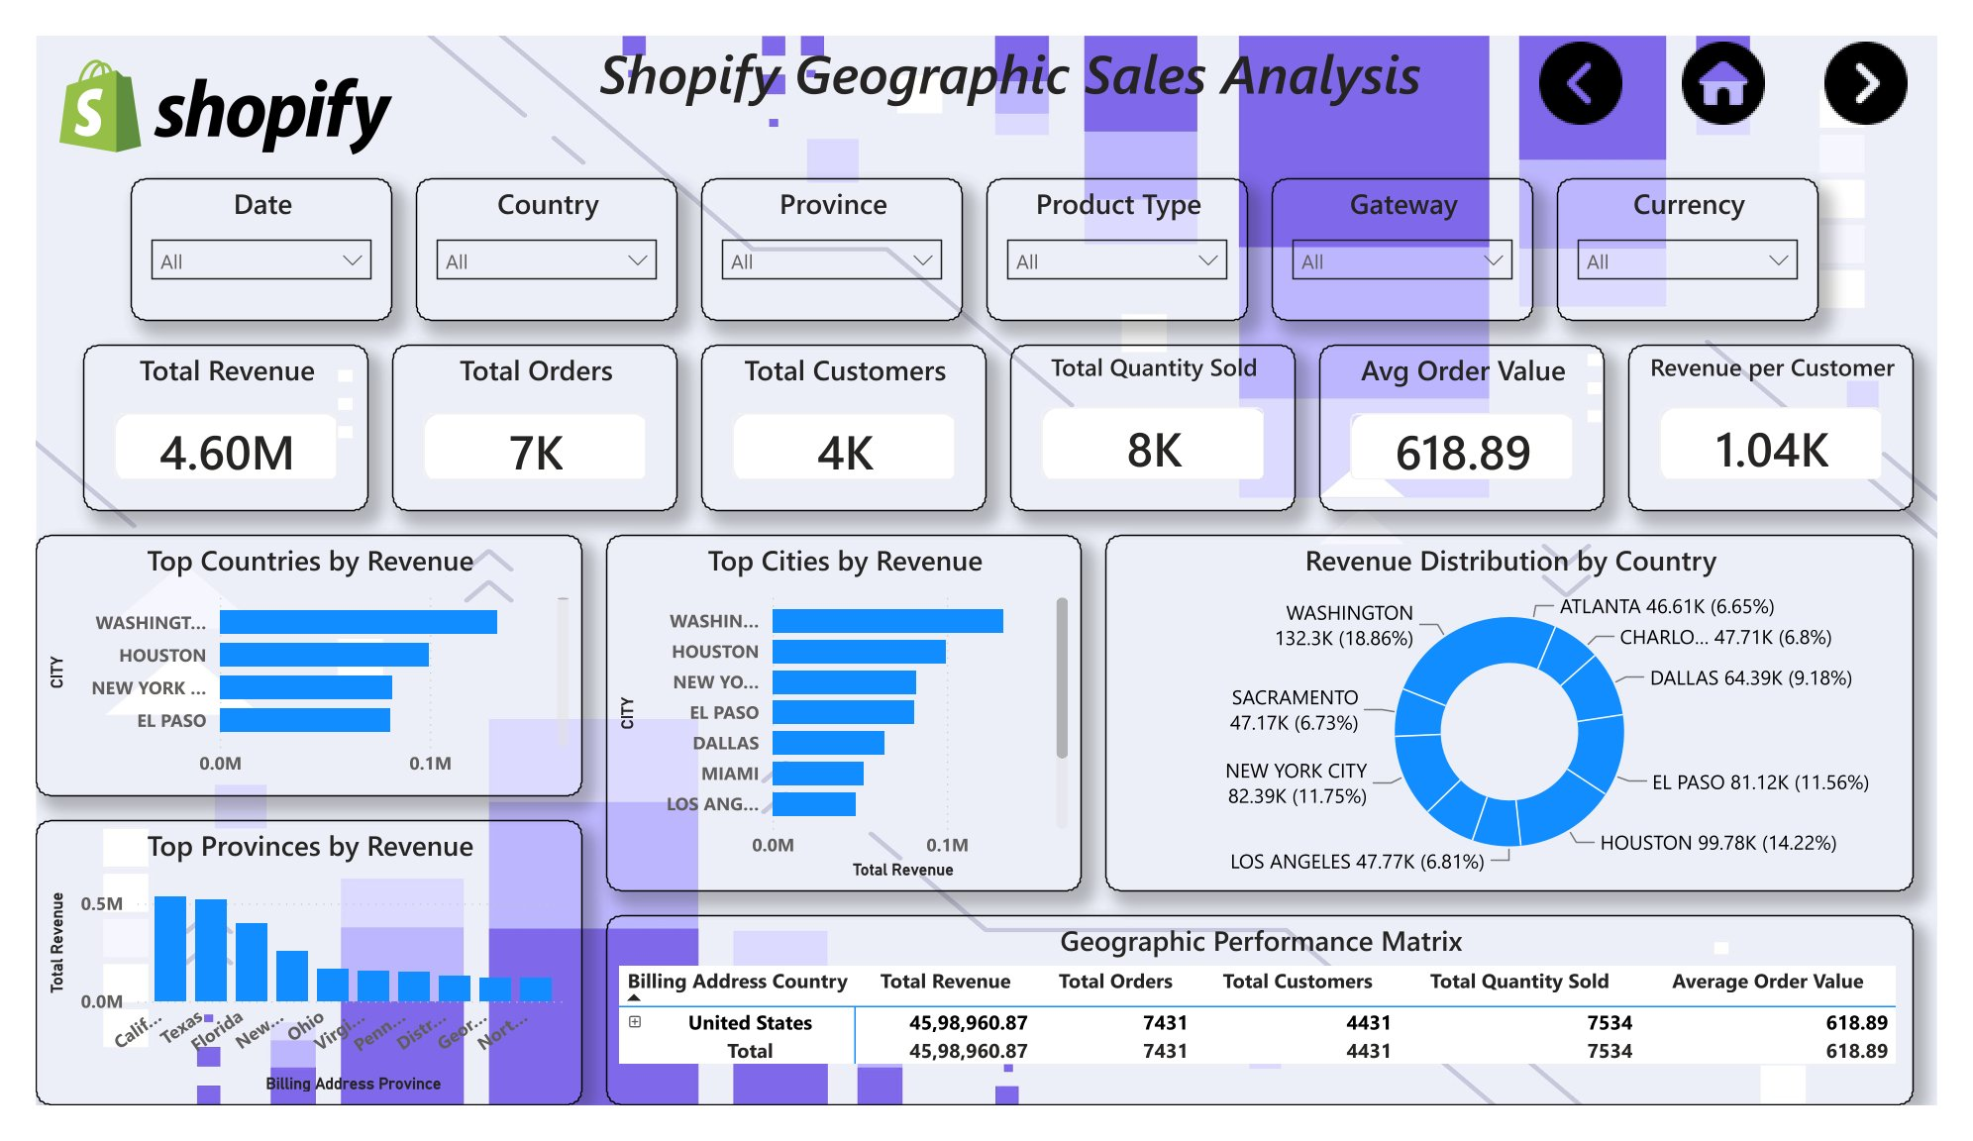
Geographic Page Layout
内容由AI生成

Slide 36
Retention Insights
Loyalty Value
Loyal customers deliver higher lifetime value. Re-engagement campaigns can improve retention.
内容由AI生成

Slide 37
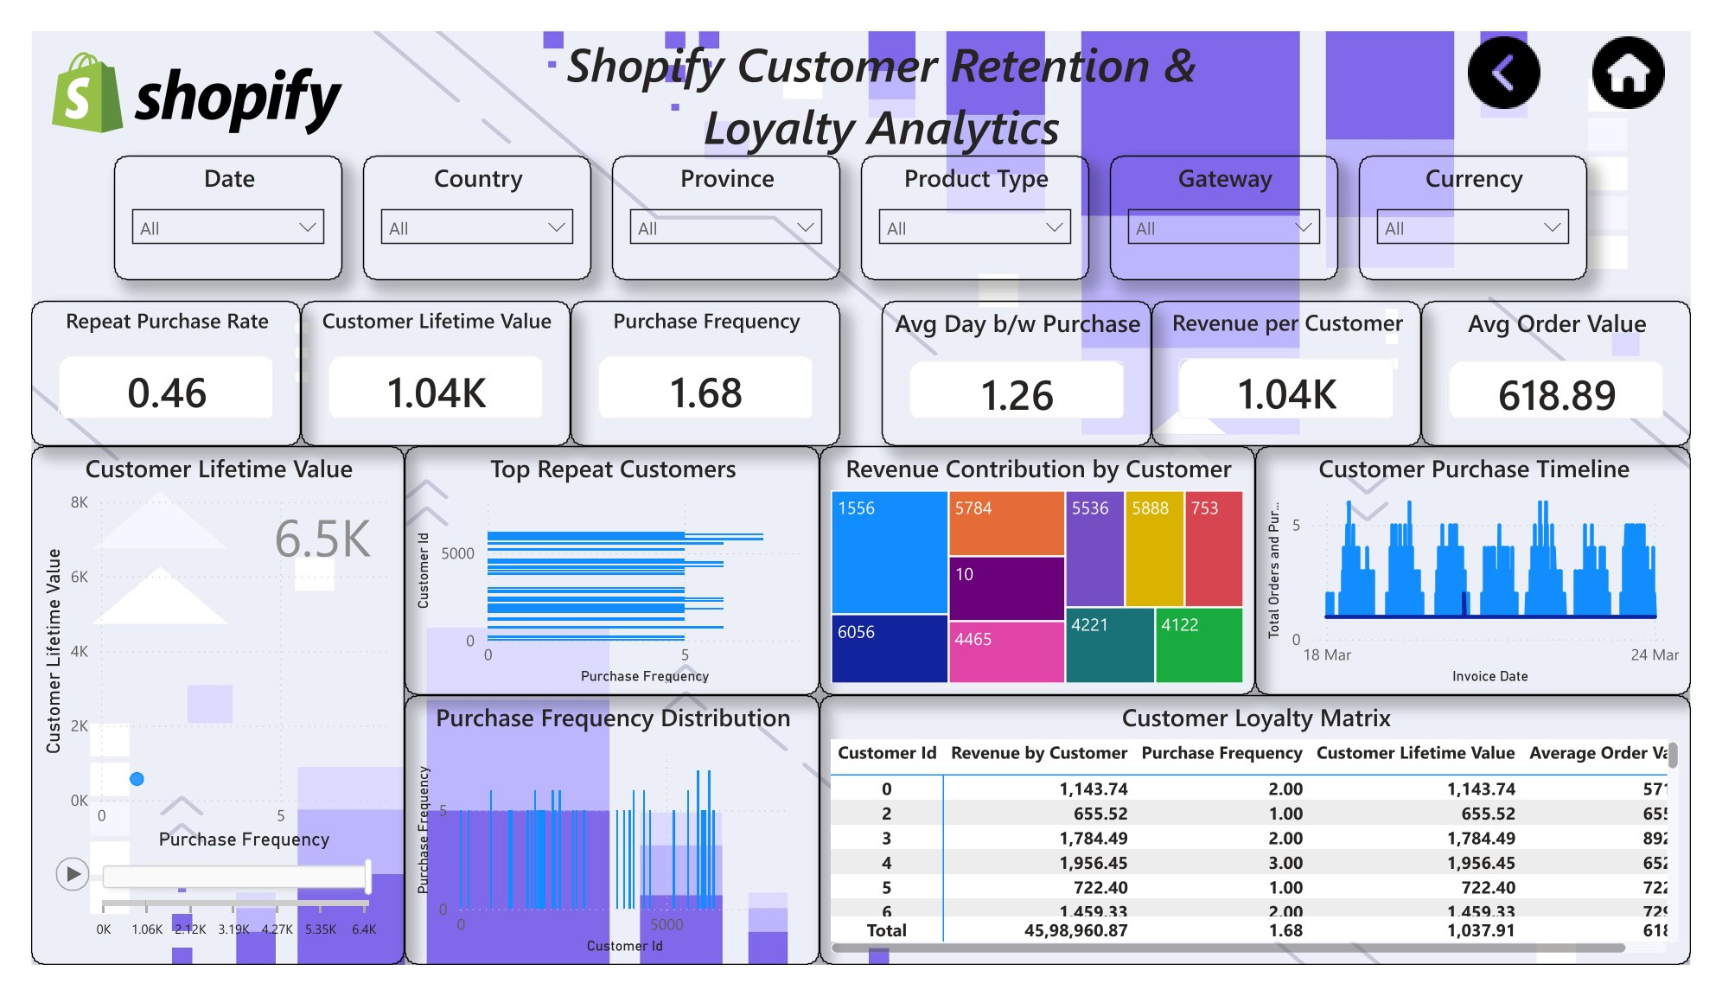
Retention Page Layout
内容由AI生成

Slide 38
Section 6: Closing
06
内容由AI生成

Slide 39
Business Recommendations
Actionable Strategies
Improve customer retention
Focus marketing on top regions
Promote high-revenue products
Monitor KPIs monthly
内容由AI生成

Slide 40
Business Impact
Measurable Value
Better decision-making
Improved sales visibility
Customer insights
Product optimization
Regional strategy
Executive reporting
内容由AI生成

Slide 41
Thank you for watching.
内容由AI生成

